Slide 1
HALLOWEEN STYLE GUIDE
2022

Slide 2
Purpose of these Guidelines
These guidelines address style and quality for a specific product category within Walmart.com
These guidelines contain key information on how to correctly format item content and fill out key attributes to ensure item is discoverable on site.
PDP Best Practices:
Clearly shows and tells about item features and benefits.
Uses supplemental rich content to educate and inspire
Is clear, correct, and error-free: please use spell check before entering information into the Full Item Spec.
Leads to higher conversion for customers.
Notes:
DESIGN NOTE: If you add or delete rows, make sure to center and middle-align the table.

Slide 3
Product Name
STRUCTURE | [Theme] + [Character] + [Gender] + [Age] + “Halloween Costume”
CHARACTER RANGE | 30 – 60 Characters
DEFINITION | Brand Is optional. Theme = Tv Show/Movie License. Gender = girls/boys/womens/mens
ADDITIONAL INSTRUCTIONS | If non licensed, use generic themes (career, animal, food, etc).
Examples:
Power Rangers Red Ranger Muscle Classic Child Halloween Costume
Toy Story Jessie Classic Adult Halloween Costume
The Little Mermaid Ariel Costume for Children with Sequin Tail, Girls 4T

Slide 4
Images
Reminders:
Everyone needs a Halloween Costume. Please use a diverse range of models, wherever possible.
Minimum of 5 images is required.

Slide 5
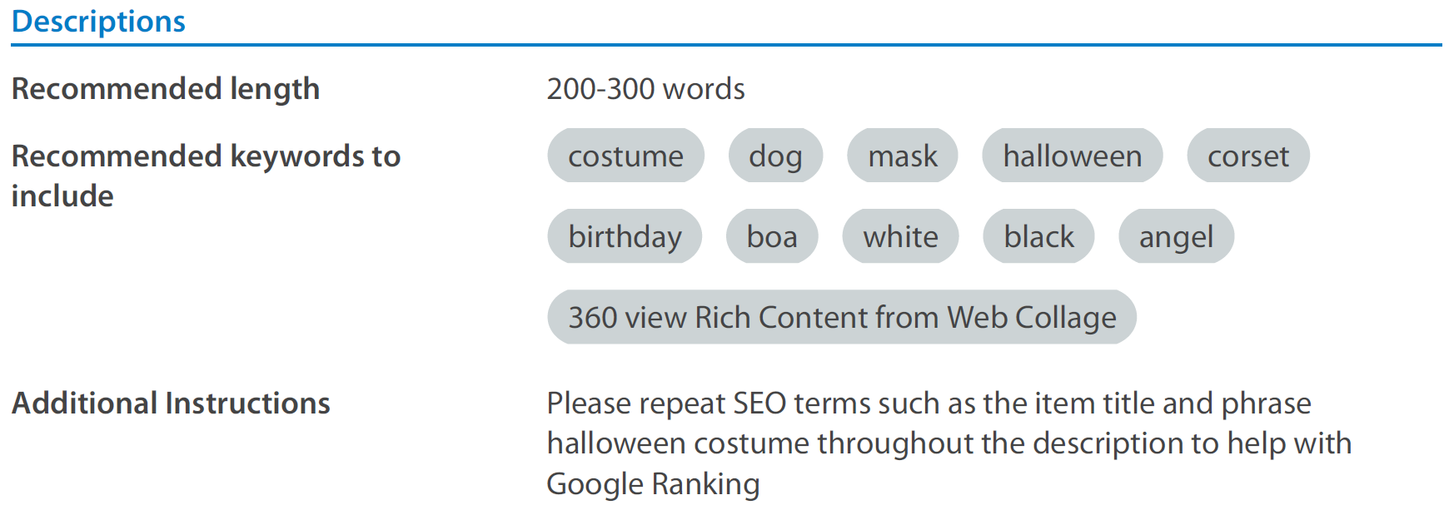
Key Features + Description

Slide 6
Key Attributes
Attribute | Key | Description | Examples/Value List
Brand | brand | Properly fill in the brand name here and spell correctly. Make sure brand name is spelled, punctuated & capitalized properly according to the brand itself. | • Oriental Trading • Rubies • Spirit Halloween
Character | character | If your item has any association with a specific character, enter the character name. This can be left blank. | • Minnie Mouse • Harry Potter • Spiderman
Occasion | occasion | The particular target time, event, or holiday for the product. If an item has multiple occasions, please list all occasions associated with an item. This can be left blank if no occasion is applicable. | All Occasion Baby Shower Back-To-School Birthday Christmas Father’s Day | Graduation Halloween Hanukkah Harvest Wedding Valentine’s Day
Color Category | color_category | Description of the standard categories of color. This should be just the color, not a descriptive phrase or sentence. This needs to be the color from the value list. For Example - something that is Color = Jet Black would have Color Category = Black. | • Beige • Black • Blue • Bronze • Brown • Clear • Gold • Gray • Green | • Multi-color • Off-White • Orange • Pink • Purple • Red • Silver • White • Yellow
Actual Color | actual_color | Description of the actual color of the item. For Example - something that is Color = Space Grey would have the Actual Color = Space Grey. | Jet Black Black Blue Aqua Lime Green Silver Space Gray

Slide 7
Key Attributes Continued
Attribute | Key | Description | Examples/Value List
Additional Features | features | Are there any additional features that need to be called out? Example: If a Costume Wings product says that it glows in the dark and is adjustable, the features value will be: Glow-in-the-dark|Adjustable | • Detachable • Glow-in-the-Dark • Adjustable • Light-Up
Age Group | age_group | General grouping of ages into commonly used demographic labels. Infant, 0-1 Toddler, 1-3 Child, 4-10 Tween, 11-13 Teen, 14-17 Adult, 18-64 Senior, 65+ | • Infant • Toddler • Child • Tween • Teen • Adult • Senior
Gender | gender | Indicate whether this item is meant for a particular gender or meant to be gender-agnostic (unisex). | • Male • Female • Unisex
Title | title | This is the title of the movie, cartoon, tv show, comic, etc. an item is associated with. | • Game of Thrones • Harry Potter • Marvel • DC
Fancy-Dress Costume Type | fancy_dress_ costume_type | This indicates what type of Fancy-Dress Costume the product is. | Funny Costumes Revealing Costumes Couple Costumes Group Costumes Celebrity Costumes Era Costumes Scary Costumes Special Needs Costumes Religious Costumes Fantasy Costumes Costume Sets

Slide 8
Trust & Safety Guidelines
We may remove an items in our sole discretion are inappropriate, including, but not limited to:
Products that are derogatory towards or may stereotype based on race, ethnicity, culture, gender, sexual orientation, religion or nationality.
Products with obscene or sexually suggestive titles, descriptions or images, including content that may sexualize an ethnicity, culture, religion, or minors.
Decline costumes or props that are overly realistic or gory, in poor taste, or may reference or depict violence.
Products that may portray, mock, glorify, or promote:
Animal Cruelty
Violence, self-harm, suicide
Natural or man-made disasters
Criminal or illegal activity
Tragic historical or news events

Slide 9
Thank you!

